Slide 1
Department of Electronics and Communication Engineering
ENGINEERING ELECTROMAGNETIC EC450
Unit 2
ENERGY AND POTENTIAL
Course Coordinator: Prof. Madhu Sudan M P

Slide 2
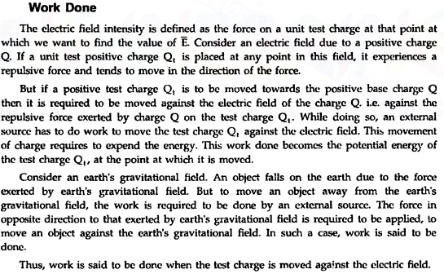

Slide 3
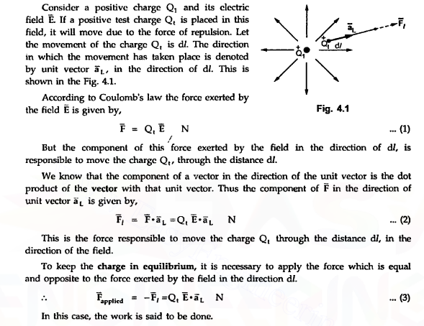

Slide 4
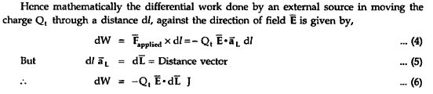
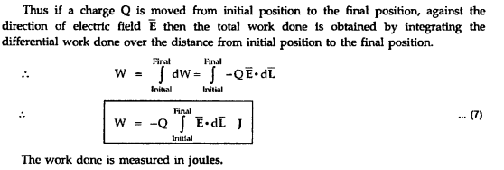

Slide 5
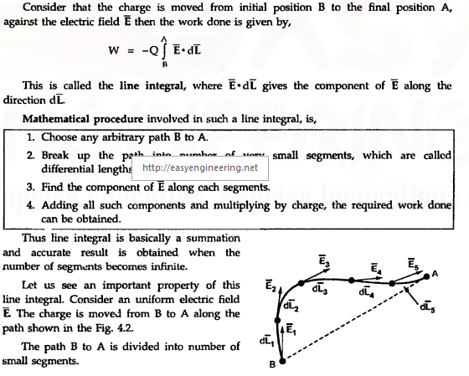

Slide 6
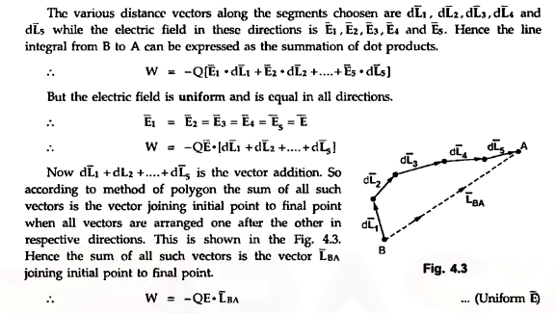

Slide 7
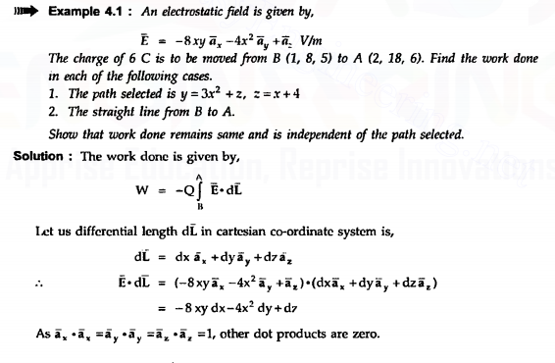

Slide 8
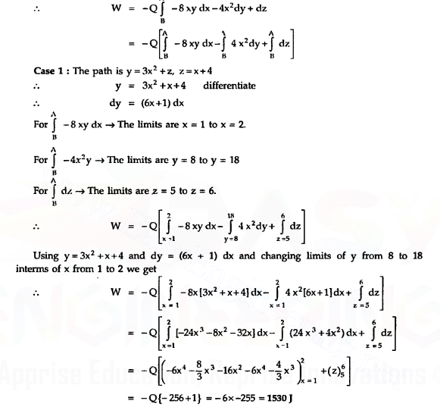

Slide 9
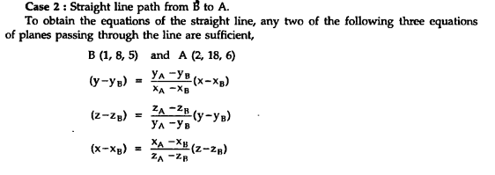
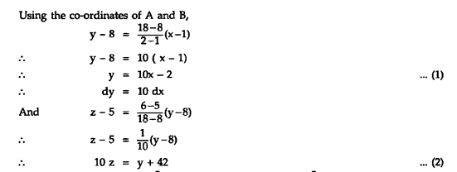

Slide 10
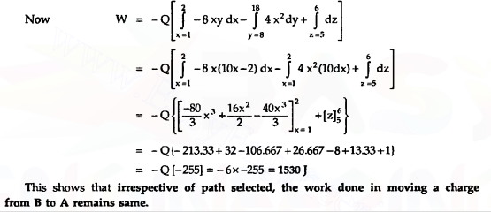

Slide 11
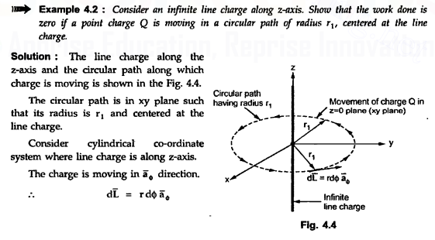
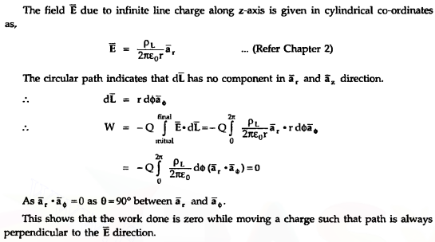

Slide 12
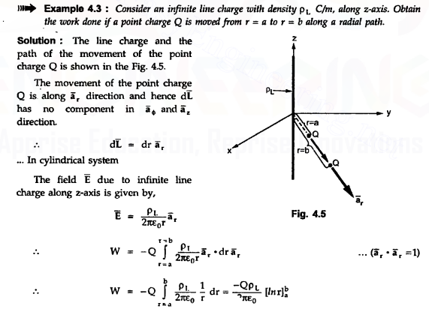
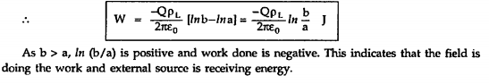

Slide 13
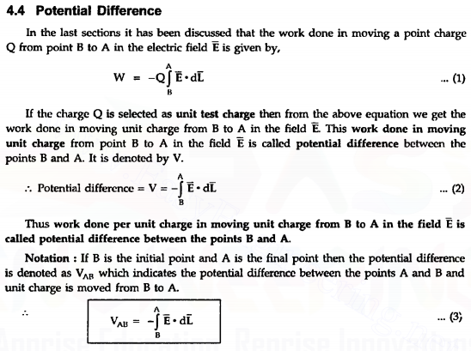

Slide 14
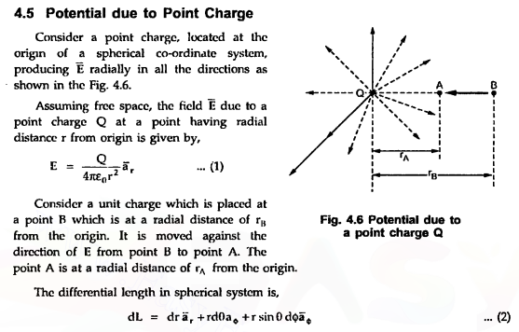

Slide 15
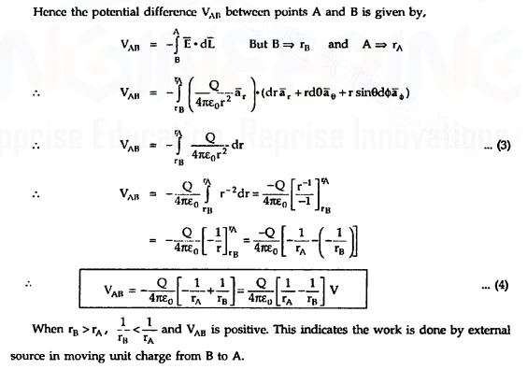

Slide 16
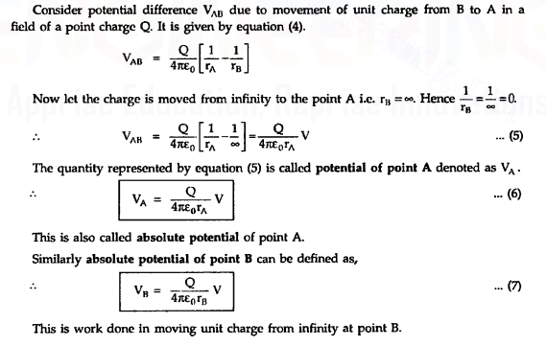
Absolute Potential

Slide 17
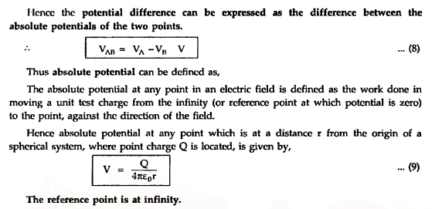

Slide 18
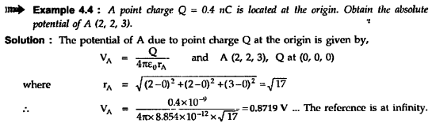
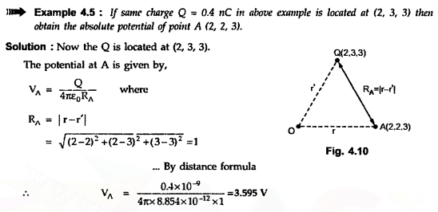

Slide 19
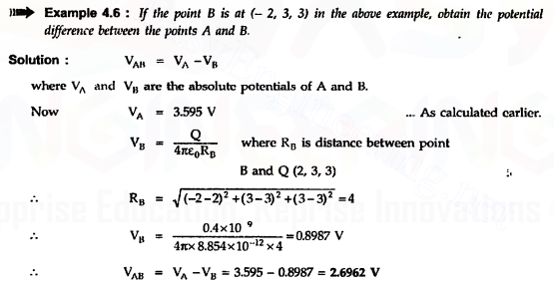
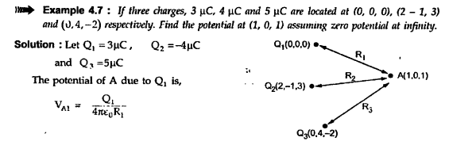

Slide 20
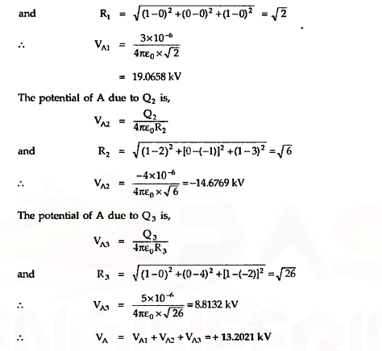

Slide 21
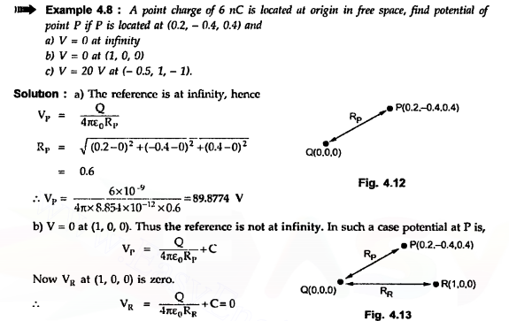

Slide 22
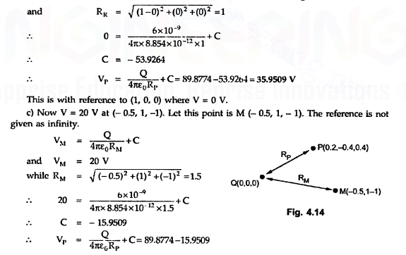

Slide 23
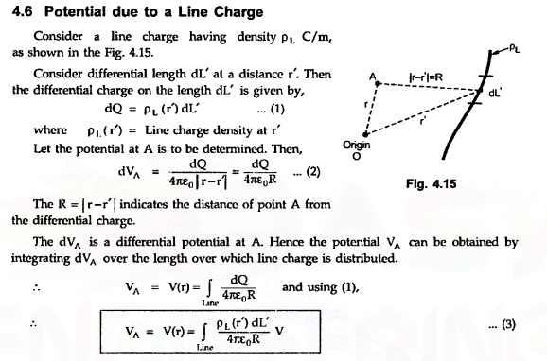

Slide 24
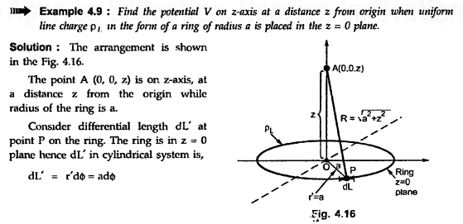
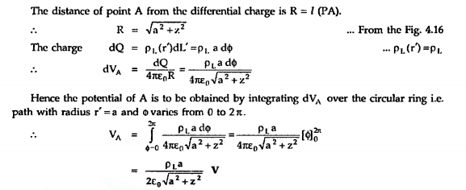

Slide 25
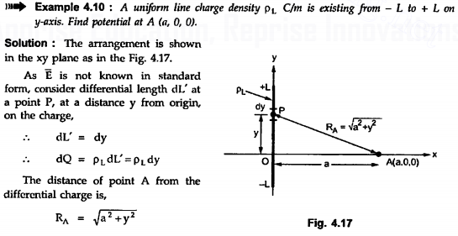

Slide 26
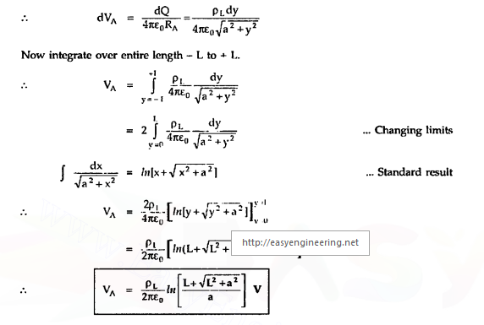

Slide 27
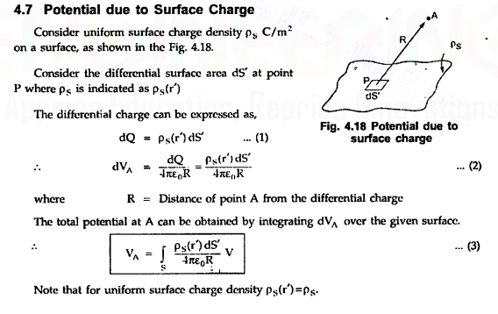

Slide 28
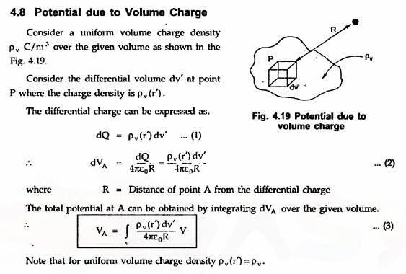

Slide 29
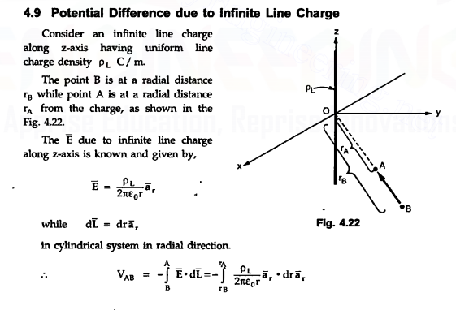

Slide 30
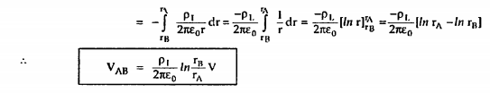

Slide 31
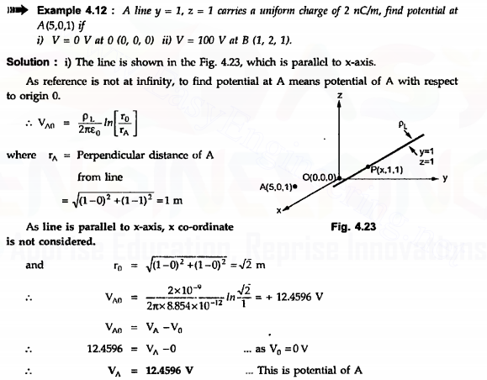

Slide 32
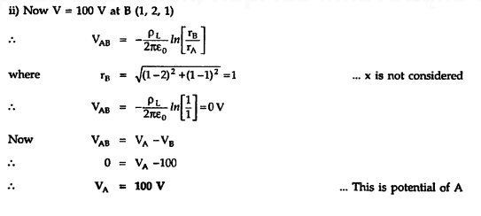

Slide 33
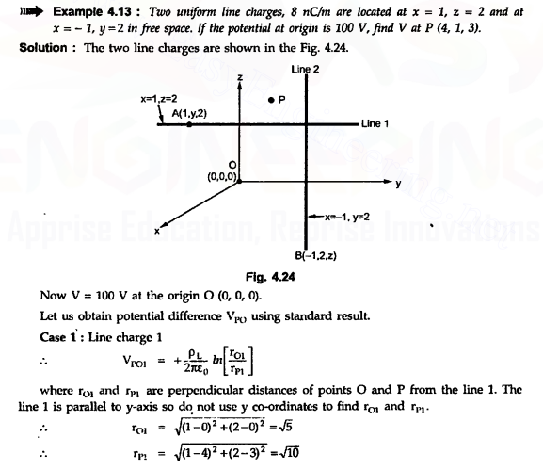

Slide 34
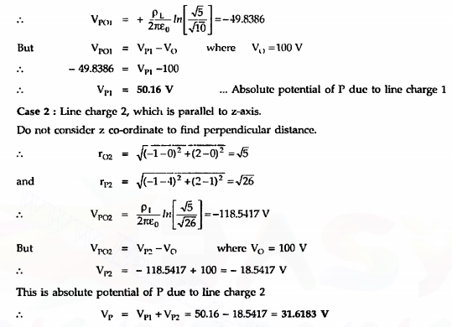

Slide 35

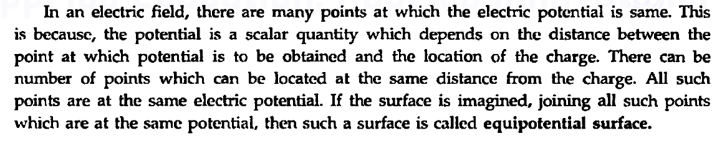
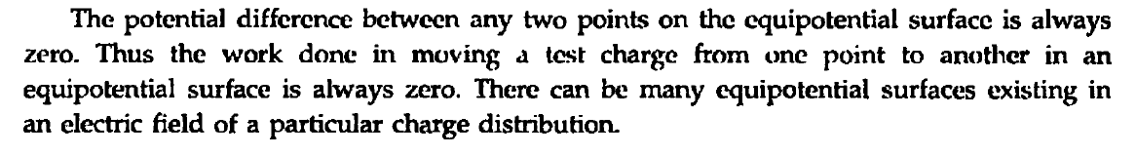

Slide 36
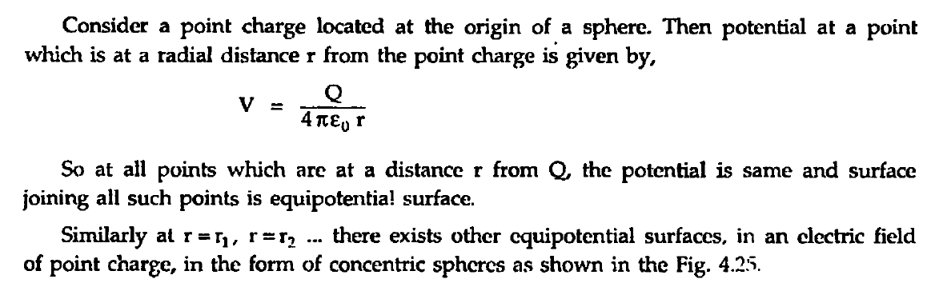
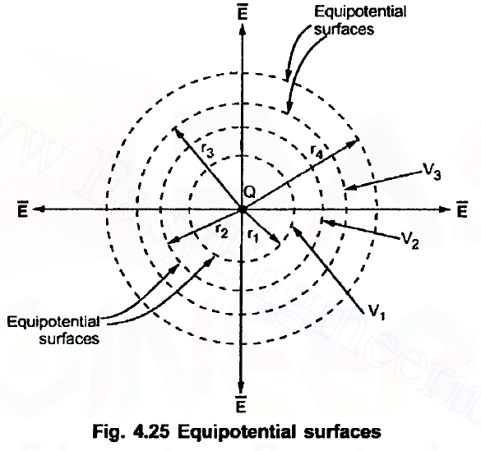

Slide 37
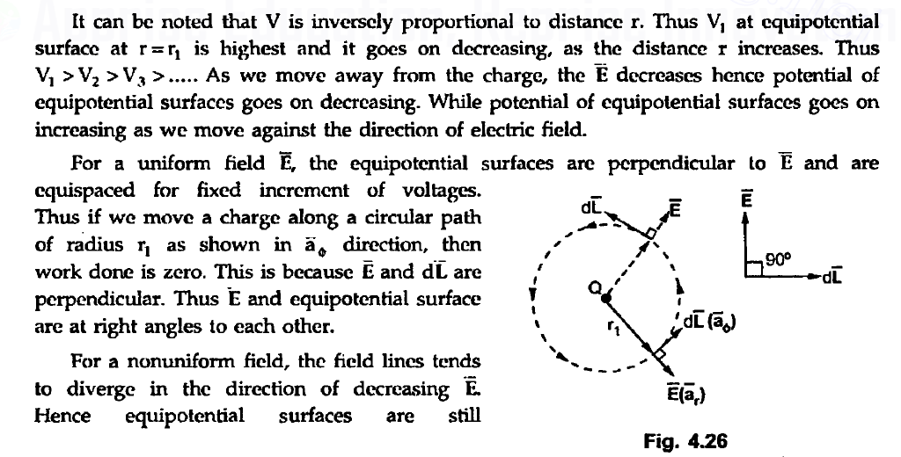

Slide 38
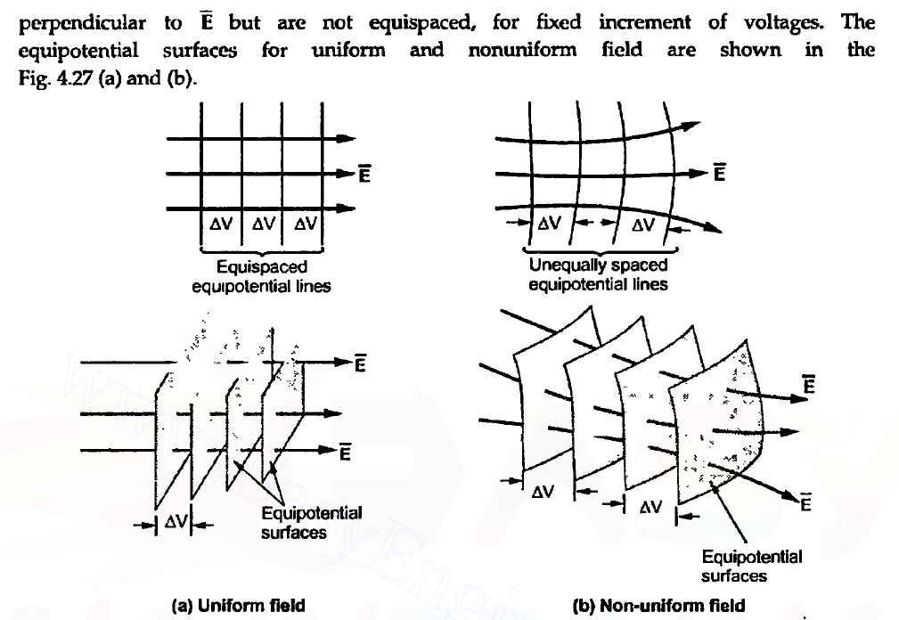

Slide 39

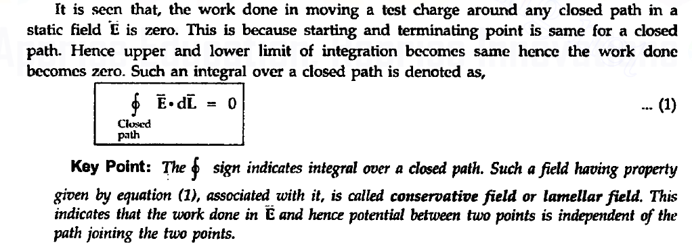

Slide 40

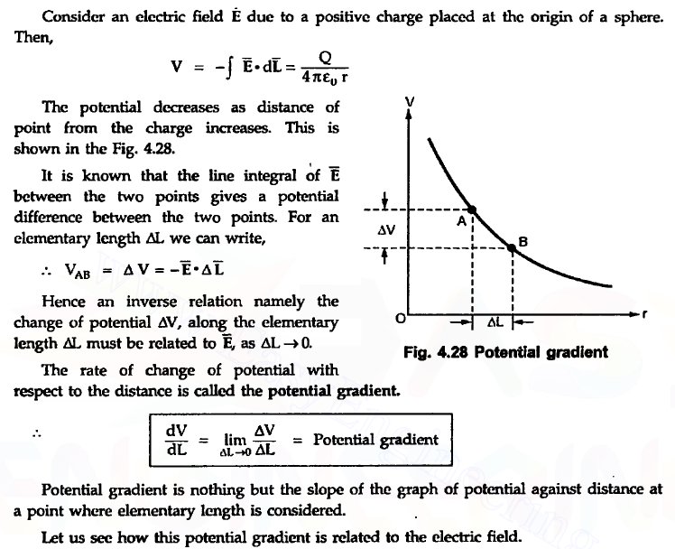

Slide 41

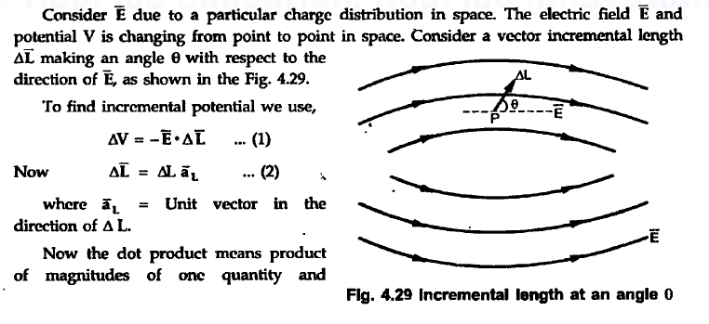

Slide 42
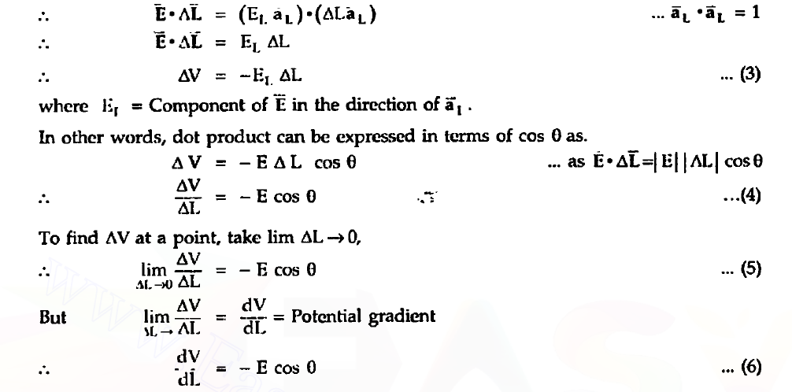

Slide 43


Slide 44


Slide 45



Slide 46


Slide 47


Slide 48


Slide 49


Slide 50


Slide 51



Slide 52


Slide 53



Slide 54


Slide 55


Slide 56


Slide 57


Slide 58


Slide 59



Slide 60


Slide 61



Slide 62


Slide 63


Slide 64


Slide 65


Slide 66


Slide 67


Slide 68


Slide 69


Slide 70


Slide 71


Slide 72



Slide 73



Slide 74



Slide 75



Slide 76


Slide 77


Slide 78


Slide 79


Slide 80


Slide 81



Slide 82


Slide 83


Slide 84



Slide 85



Slide 86


Slide 87


Slide 88


Slide 89


Slide 90


Slide 91



Slide 92


Slide 93


Slide 94


Slide 95



Slide 96



Slide 97


Slide 98



Slide 99



Slide 100


Slide 101


Slide 102


Slide 103


Slide 104


Slide 105


Slide 106


Slide 107


Slide 108


Slide 109


Slide 110


Slide 111


Slide 112


Slide 113


Slide 114


Slide 115


Slide 116


Slide 117


Slide 118


Slide 119


Slide 120


Slide 121


Slide 122


Slide 123


Slide 124


Slide 125


Slide 126


Slide 127


Slide 128


Slide 129


Slide 130


Slide 131



Slide 132


Slide 133



Slide 134


Slide 135


Slide 136



Slide 137



Slide 138



Slide 139


Slide 140



Slide 141


Slide 142


Slide 143


Slide 144


Slide 145


Slide 146


Slide 147



Slide 148



Slide 149



Slide 150


Slide 151


Slide 152


Slide 153


Slide 154


Slide 155


Slide 156


Slide 157


Slide 158


Slide 159


Slide 160



Slide 161


Slide 162



Slide 163


Slide 164


Slide 165


Slide 166


Slide 167


Slide 168


Slide 169


Slide 170


Slide 171


Slide 172


Slide 173


Slide 174



Slide 175


Slide 176


Slide 177


Slide 178


